Slide 1
Health Insurance Fraud Claim and Amount Prediction
Nazari Sai Deepak
Sathvika Reddy
Sai Srikar Gurthuru

Slide 2
Introduction
Health insurance fraud involves practices like billing for services not provided, upcoding, unbundling, kickbacks, and identity theft by healthcare providers or patients.
Detecting fraudulent claims and determining the amount involved is crucial but challenging due to the volume of claims and sophisticated fraud methods.
Effective fraud detection protects the financial integrity of healthcare, ensures patient well-being, and maintains public trust. Implementing robust fraud detection measures requires collaboration among stakeholders to combat this issue and enable ethical healthcare delivery.

Slide 3
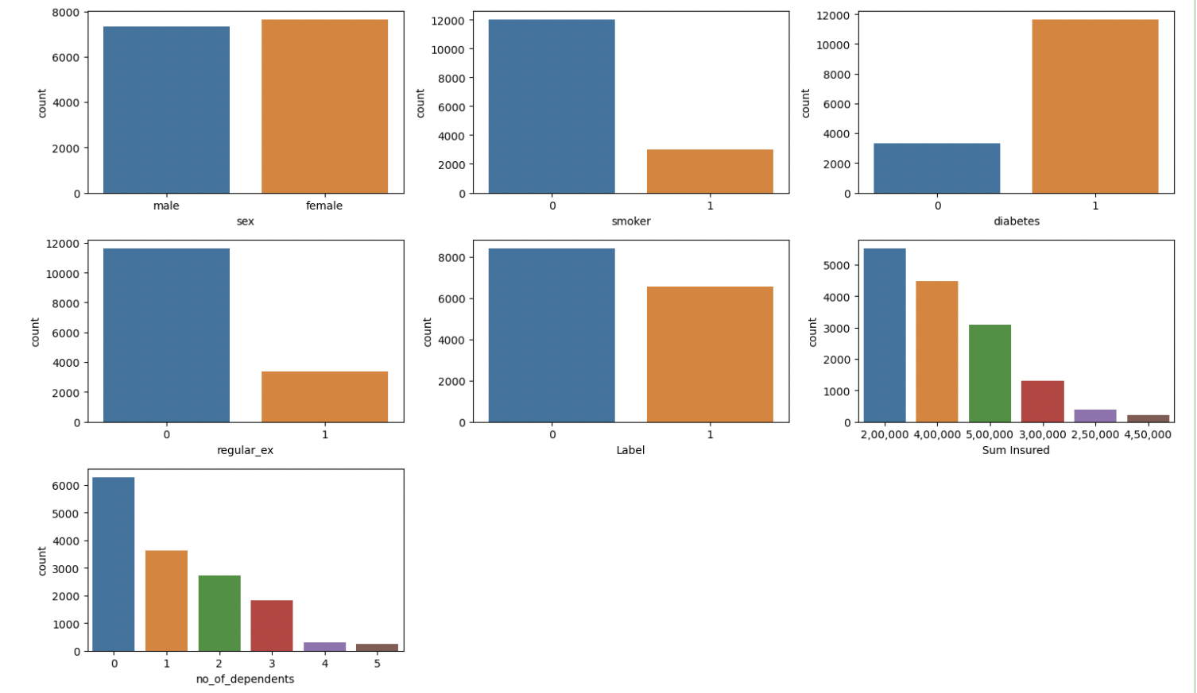
EDA
Visualising the categorical features

Slide 4
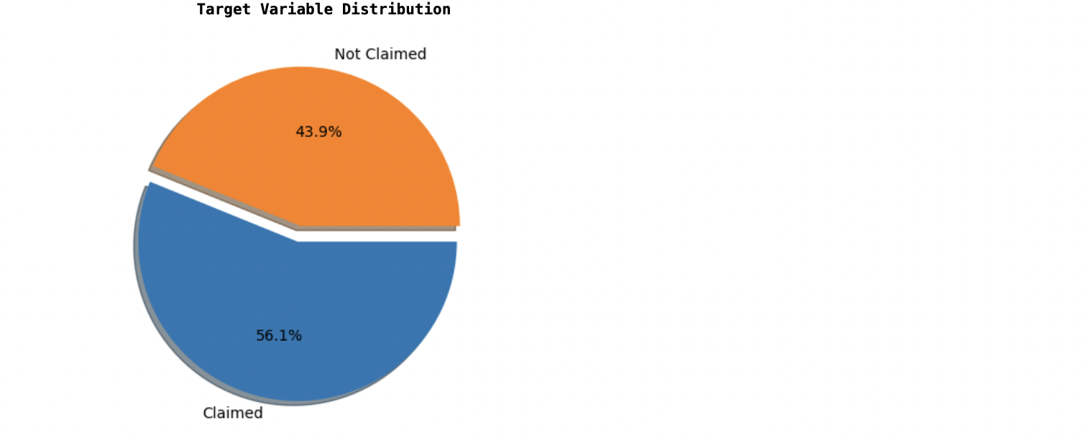
Target Variable Distribution

Slide 5
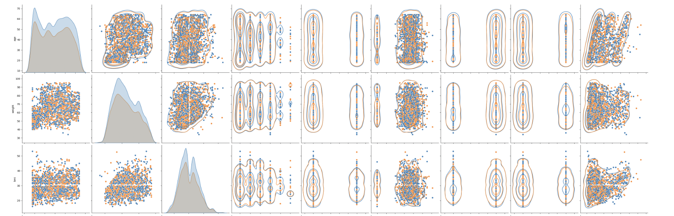
Relationship of AGE, WEIGHT AND BMI to all the features

Slide 6
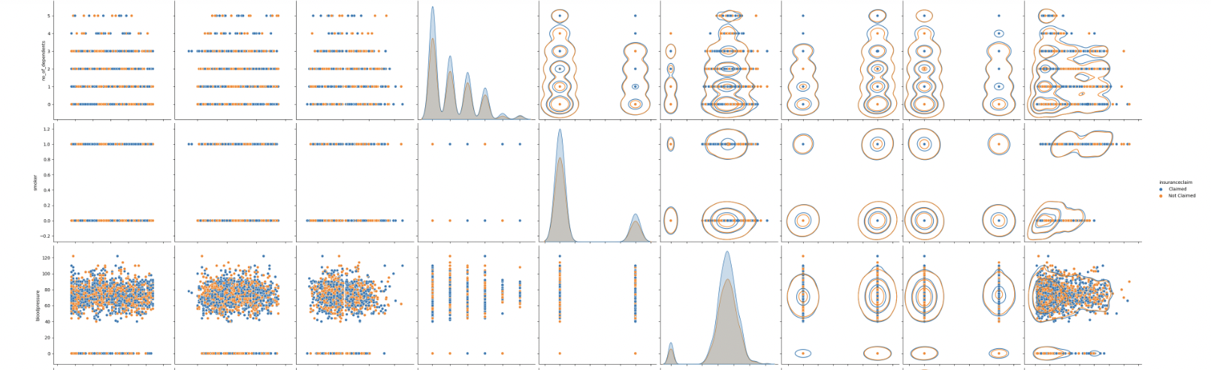
Relationship of Dependents, Smoker and Bloodpressure to all the features

Slide 7
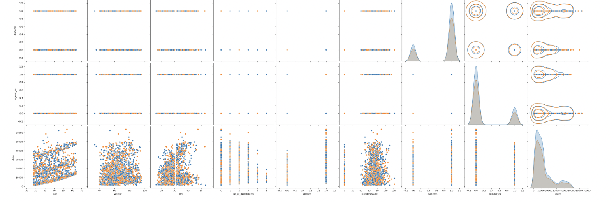
Relationship of Diabetes, regular_ex and claim to all the features

Slide 8
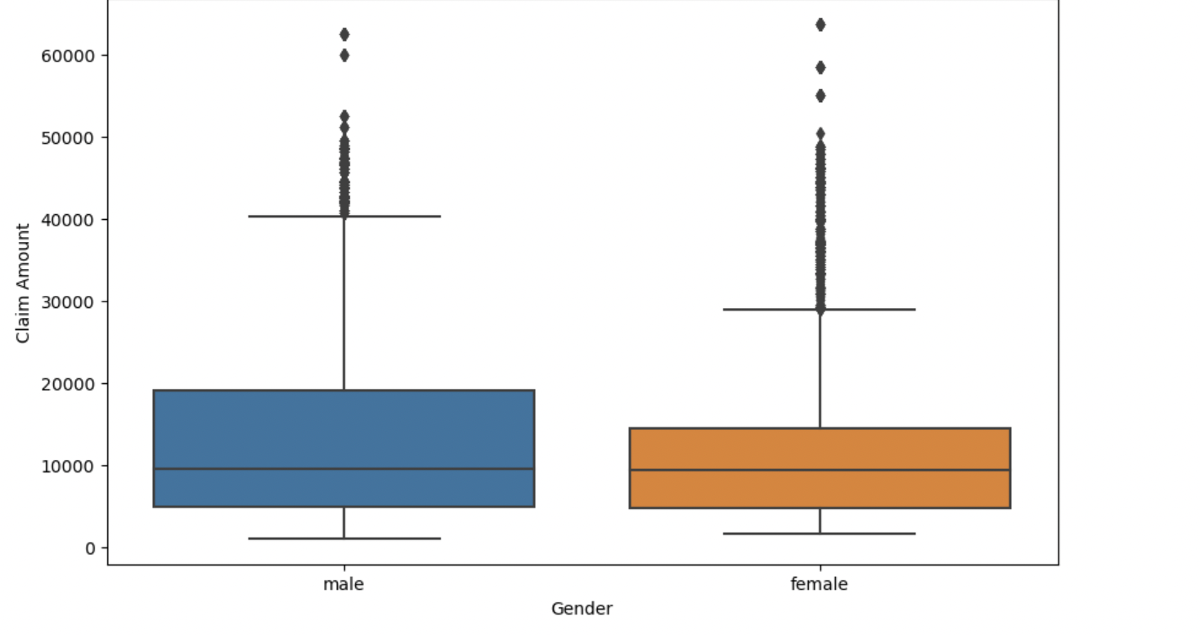
Claim Amount by Gender

Slide 9
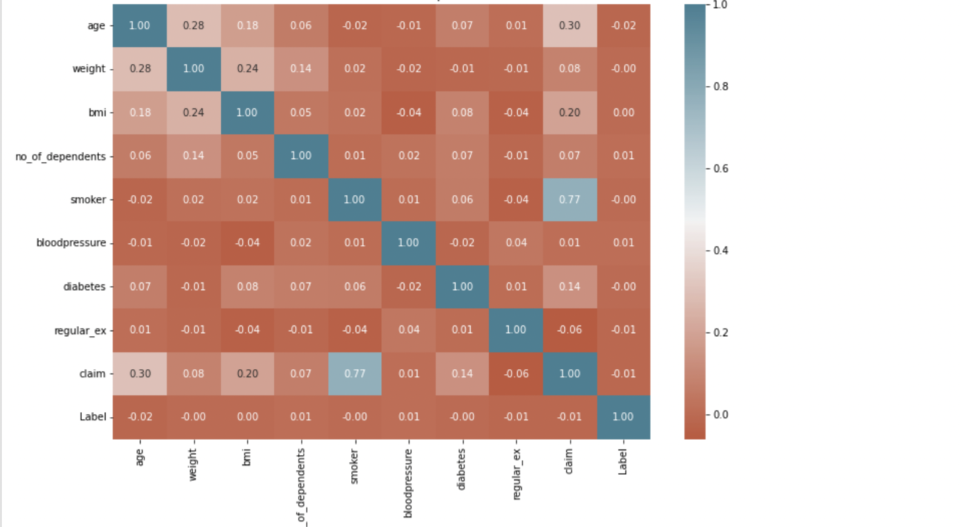
Correlation Heat Map

Slide 10
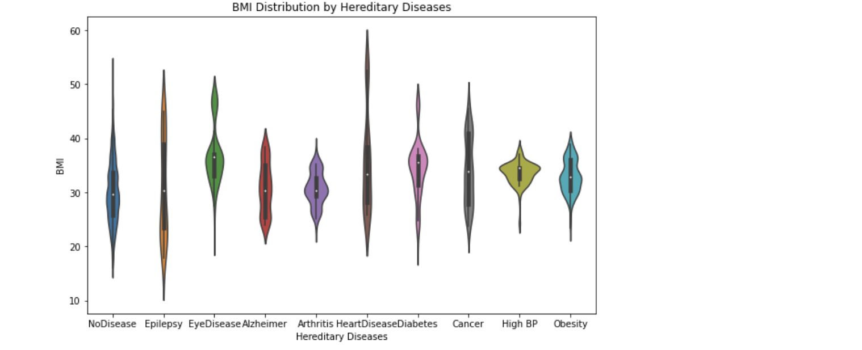
Violin Plot

Slide 11
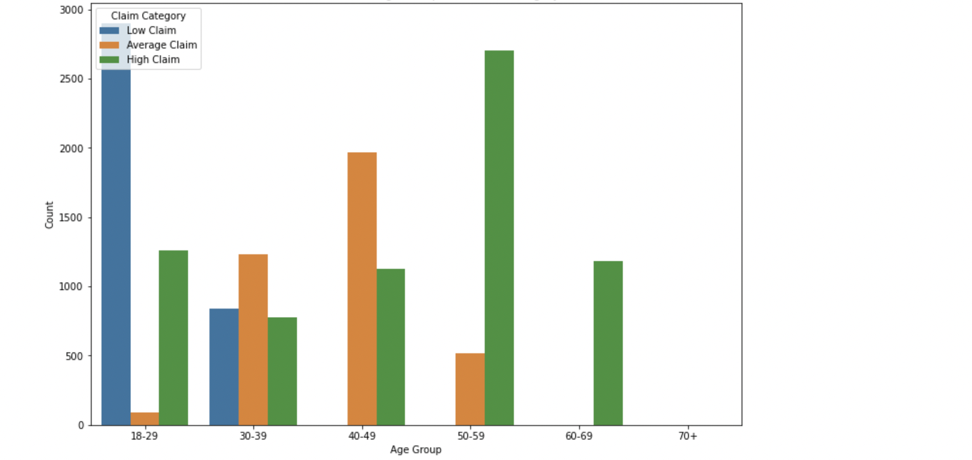
Relationship Between age group and claim category

Slide 12
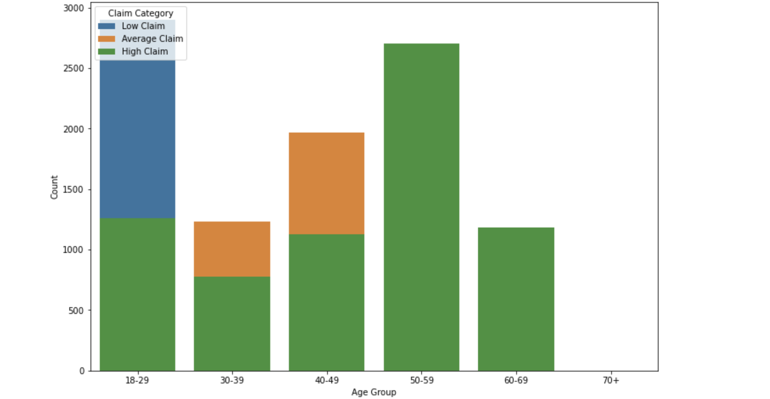
Relationship Between age group and claim category(Overlapping)

Slide 13
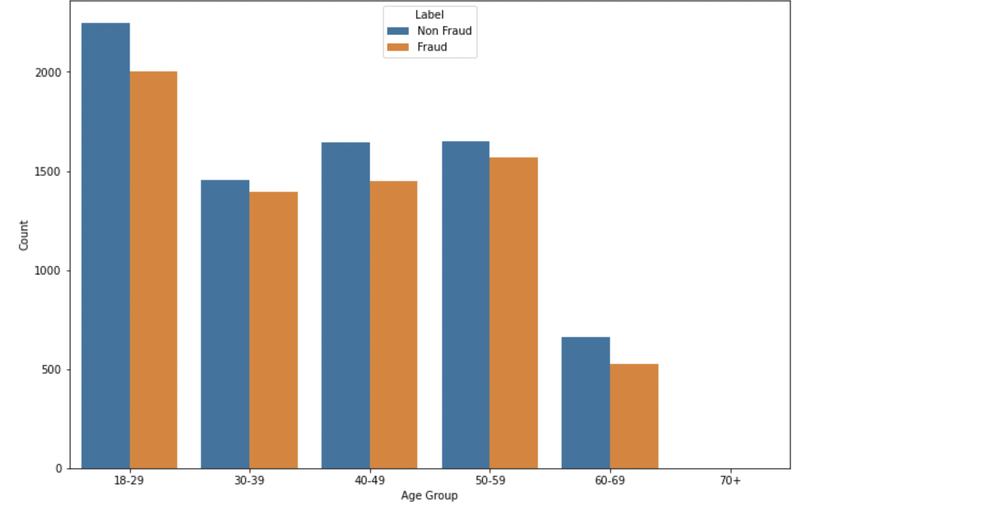
Relationship between Age Group and Label (0: Non Fraud, 1: Fraud)

Slide 14
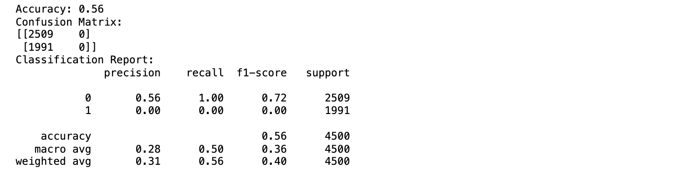
Models
Logistic regression

Slide 15
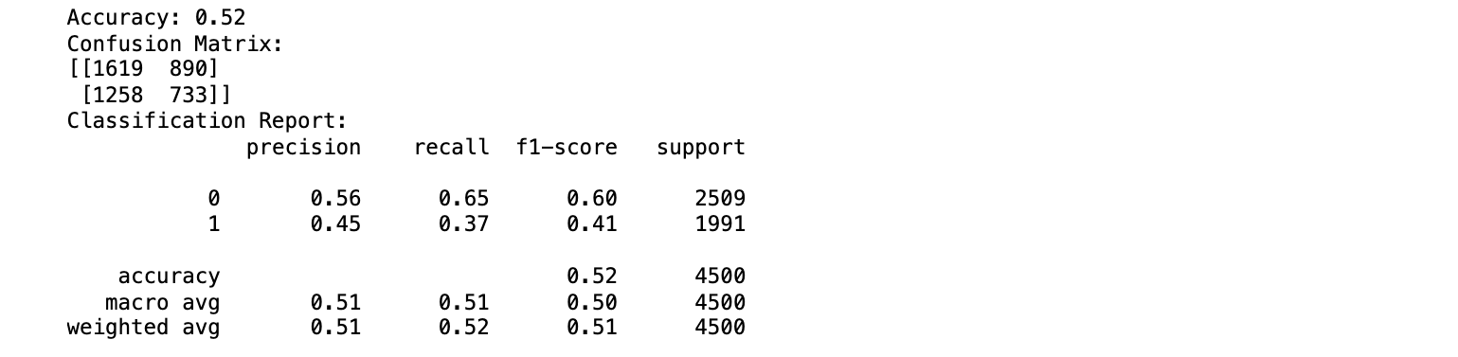
Random Forest Classifier

Slide 16
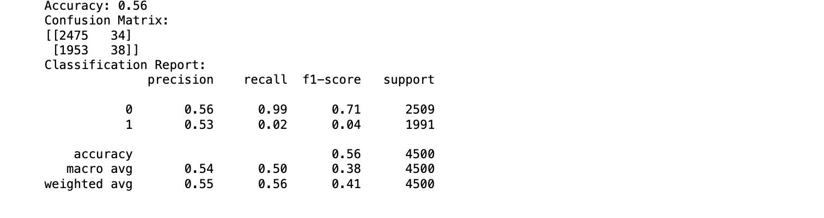
Gaussian Naive Bayes Classifier

Slide 17
SMOTE (Synthetic Minority Oversampling Technique)
SMOTE (Synthetic Minority Over-sampling Technique) is a popular oversampling technique used in our data set to address the issue of class imbalance in the feature Label.
By applying SMOTE, our model is trained on a more balanced dataset, reducing the bias towards the majority class and improving its ability to detect the minority class instances (fraudulent claims).

Slide 18
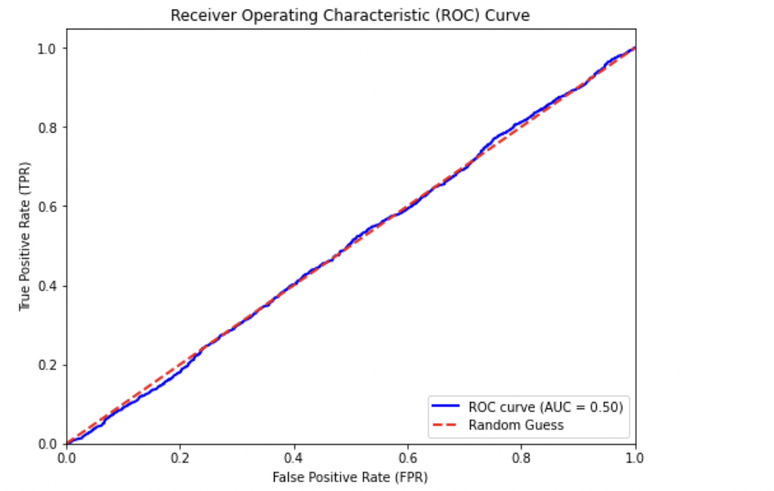
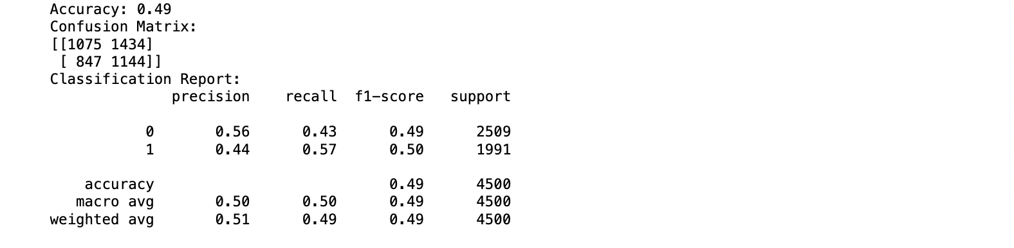
After SMOTE
Logistic Regression

Slide 19
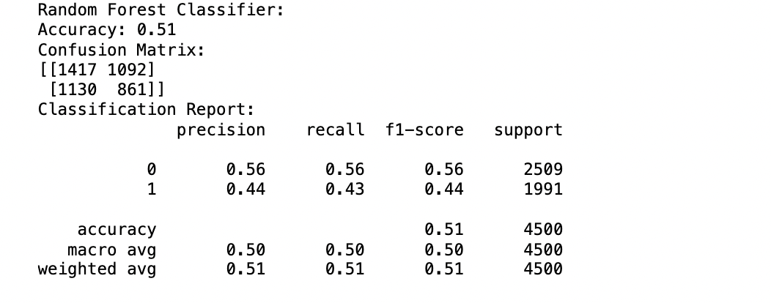
Random Forest Classifier

Slide 20
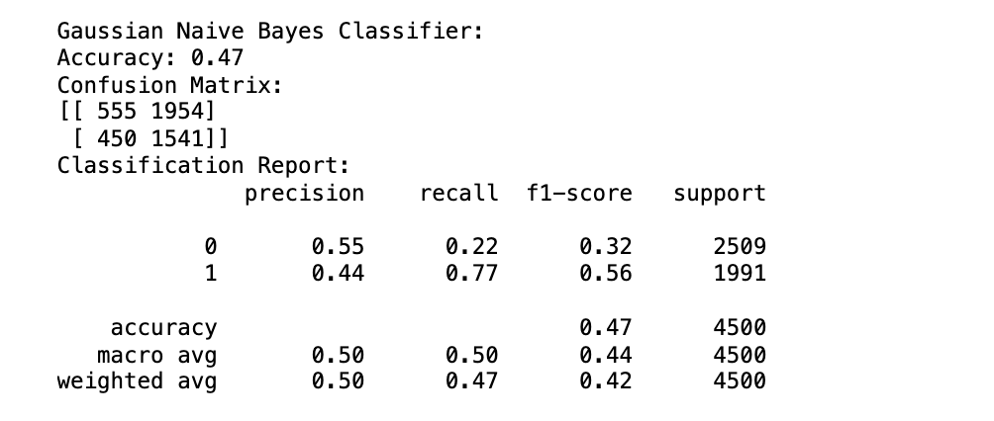
Gaussian NB Classifier

Slide 21
Note
Based on the performance of the three models on our balanced data set, the accuracy levels of these binary classification models are relatively low, ranging from 47% to 51%, which is not sufficient for accurate fraud prediction due to which we tried to predict claim amount.
Accurate claim amount forecasts enable insurers to maintain appropriate reserves, price their products competitively, and effectively manage their overall risk exposure. This, in turn, helps ensure operational efficiency, regulatory compliance, and an enhanced customer experience.
By leveraging predictive models to forecast claim amounts, insurers can make well-informed decisions about resource allocation, reinsurance, and capital management.
Ultimately, the ability to accurately predict claim amounts is a strategic imperative for insurance companies, as it underpins their financial stability, operational effectiveness, and the delivery of valuable services to policyholders.

Slide 22
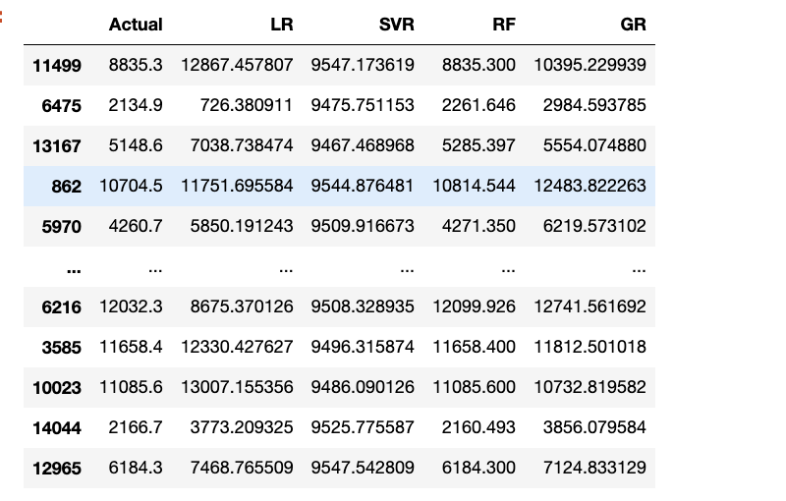
Claim Amount Prediction
Models
Linear Regression
Support Vector Regression
Random Forest
Gradient Boosting

Slide 23
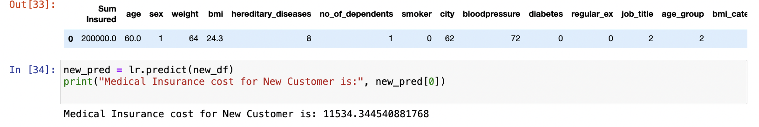
Linear Regression
A trained linear regression model is used to predict the medical insurance cost for a new customer.
The predicted value of $11,534.34 is the model's estimate based on historical data patterns.

Slide 24
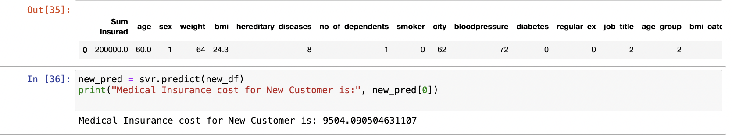
Support Vector Regression
A trained Support Vector Regression (SVR) model is used to predict the medical insurance cost for a new customer.
The predicted value of $9,504.09 is the model's estimate based on historical data patterns.
This predictive capability helps insurers with pricing, underwriting, and customer acquisition decisions.

Slide 25
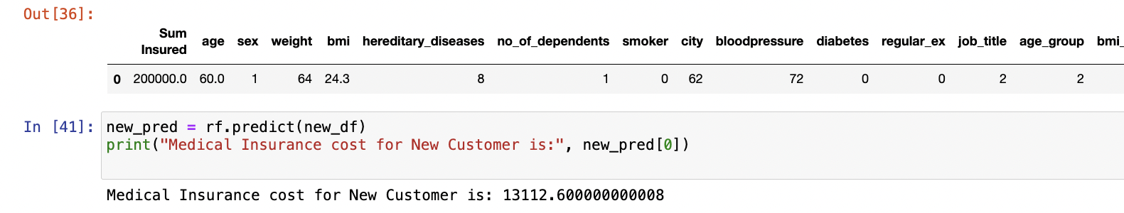
Random Forest
The model predicted a medical insurance cost of $13,112.60 for a new customer.
The Random Forest Regression model demonstrates its effectiveness in predicting medical insurance costs, with the predicted cost for a new customer falling within the expected range.

Slide 26
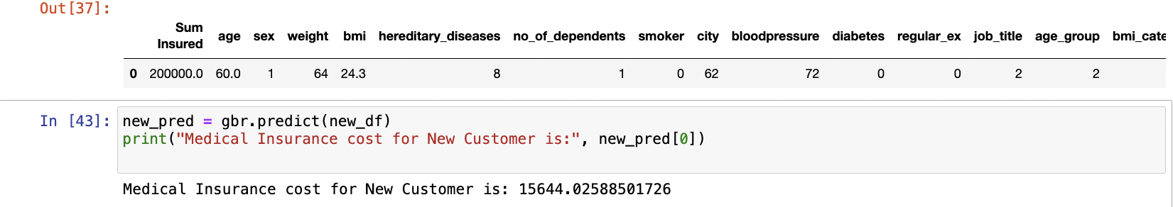
Gradient Boosting
The model successfully predicted the medical insurance cost for a new customer to be $15,644.03.
Gradient Boosting Regressors can effectively model complex relationships in healthcare data.
This approach can provide valuable insights for pricing and risk assessment.

Slide 27
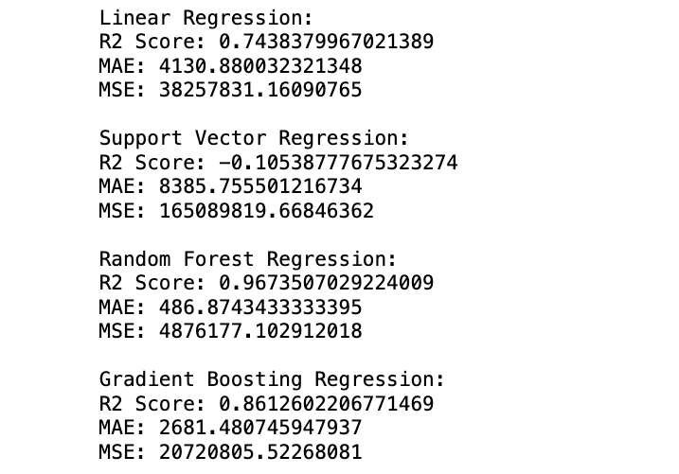
Claim Amount Prediction Results

Slide 28
Comparative Analysis of Regression Model Performance
Based on the model performance metrics, the Random Forest Regression model appears to have the best overall performance, with the highest R-squared score 0.9674.
Mean Absolute Error (MAE) of 486.87, and a Mean Squared Error (MSE) of 4,876,177.10. This indicates that the Random Forest Regression model is able to explain approximately 96.74% of the variance in the target variable and has relatively low average absolute and squared errors compared to the other models.

